Slide 1


June, 2025
Predict and prevent tropical disease spread with climate-smart AI
Alexa Bowman
Diana Shakhova
Adeline Wang
Wania Gondal
Mahtab Hoorzad
BaSc, CS ??
MaSc, SYDE
??
??
??

Slide 2

Over 1 billion people are affected by NTDs

Slide 3
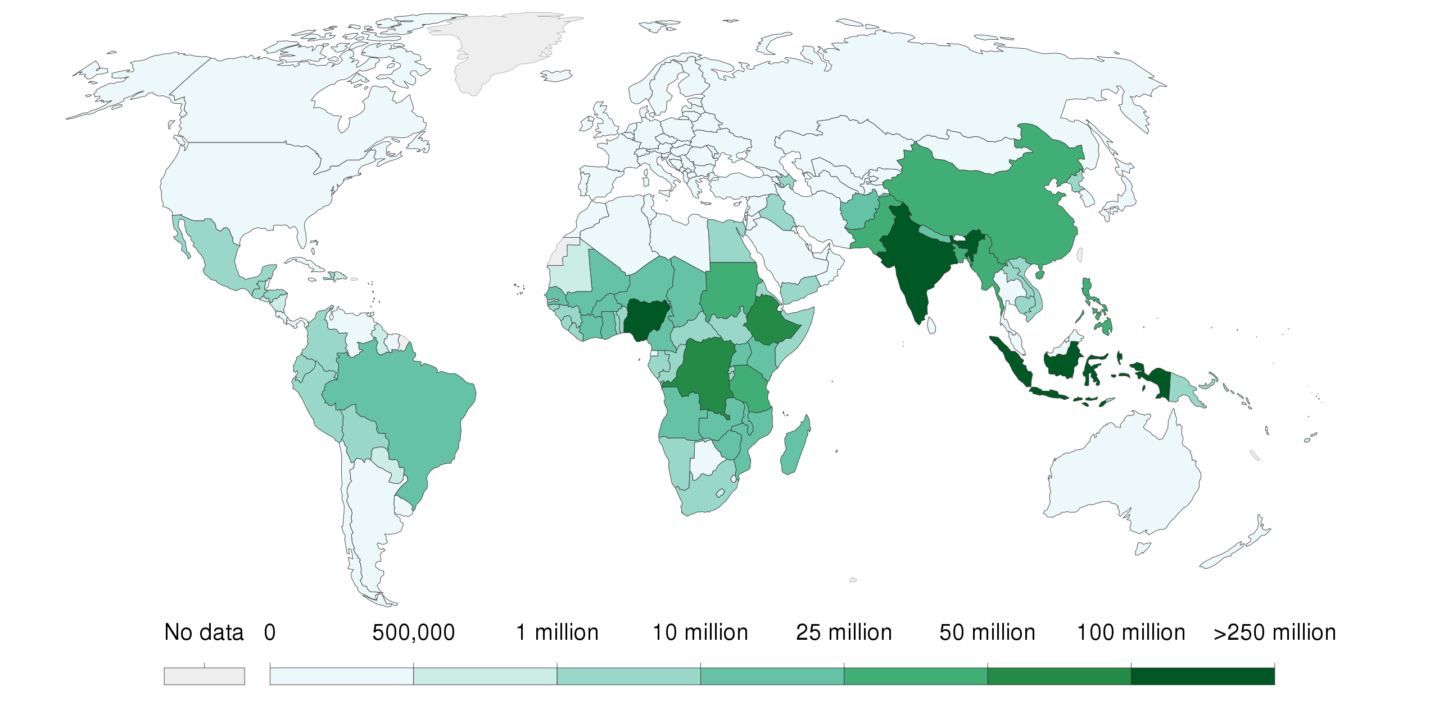

People requiring interventions against NTDs
Source: WHO
Southern Europe
Mid U.S.
East Africa

Slide 4
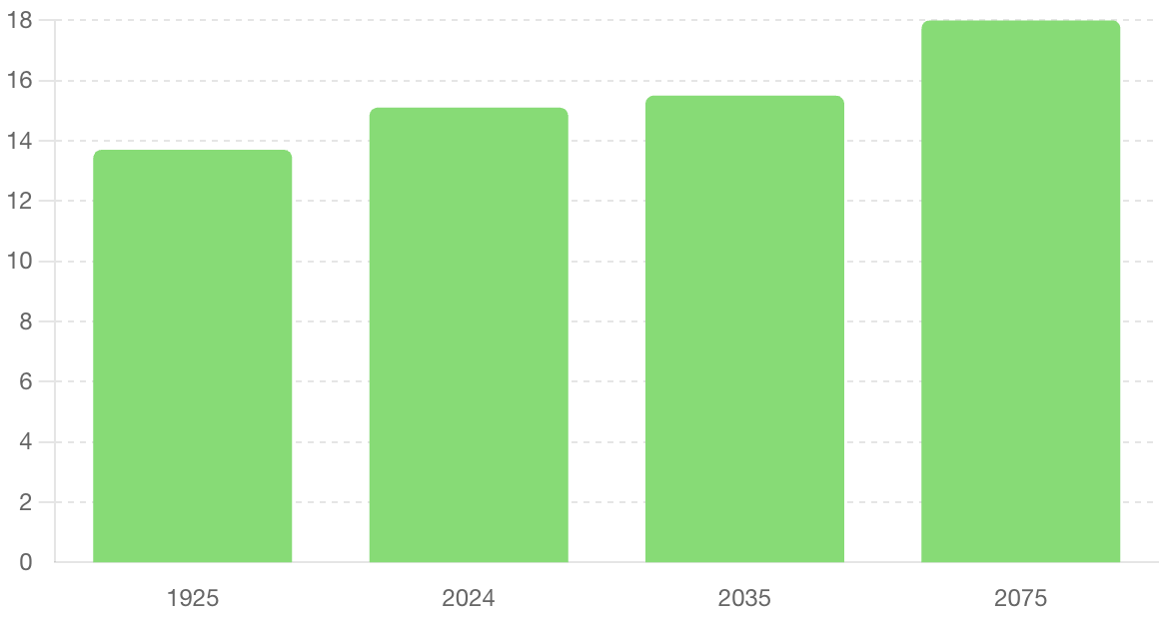
Global Surface Temperature
Page 2
18
15
15.5
13.7
Temperature, °C

Slide 5
How do we forecast future hotspots for NTDs driven by climate change?

Slide 6
spot tomorrow’s outbreaks Today.

Slide 7
Competitors
Scope
Geographic Focus
Modeling Approach
Sustainability and Scalability
User Interface
Zoniq
CLIMSEDIS
Arborverse
IMACS

